Slide 1
Retrieval-Based Question Answering for O-RAN Documents Using LLMs
By:
Adithya Swarna
Notes:
Good afternoon, everyone. My name is Adithya, and today I’ll be presenting my CS260 project, titled ‘Summarization and Retrieval-Based Question Answering for O-RAN Documents Using LLMs.’ This project focuses on building a system that automates document processing, enabling users to query complex O-RAN documents efficiently. I’ll be walking you through the problem, the high-level design, implementation, challenges, evaluation, and key lessons learned.

Slide 2
Introduction
Background:
O-RAN: A new telecom paradigm emphasizing interoperability and vendor neutrality.
O-RAN documents are large, complex, and technical.
Challenges:
Difficulty in searching and understanding key information.
Time-intensive manual processing.
Impact on telecom engineers' decision-making.
Objective:
Automate document processing for efficient retrieval and question answering.
Notes:
Open Radio Access Network, or O-RAN, is an innovative concept in telecommunications that emphasizes interoperability, flexibility, and vendor neutrality. However, with innovation comes complexity—O-RAN technical documents are vast and highly technical.
Imagine going through hundreds of pages of dense technical documentation just to locate one critical piece of information. It’s a time-intensive and error-prone process. This challenge is especially critical for telecom engineers who need quick access to specific details for decision-making and operations. This isn’t just about time—it’s about operational efficiency. A faster way to access this information can make all the difference.
This project addresses this issue by creating a system that automates document processing, allowing users to retrieve relevant information and get their queries answered directly from the documents. This improves efficiency and usability of O-RAN documentation.

Slide 3
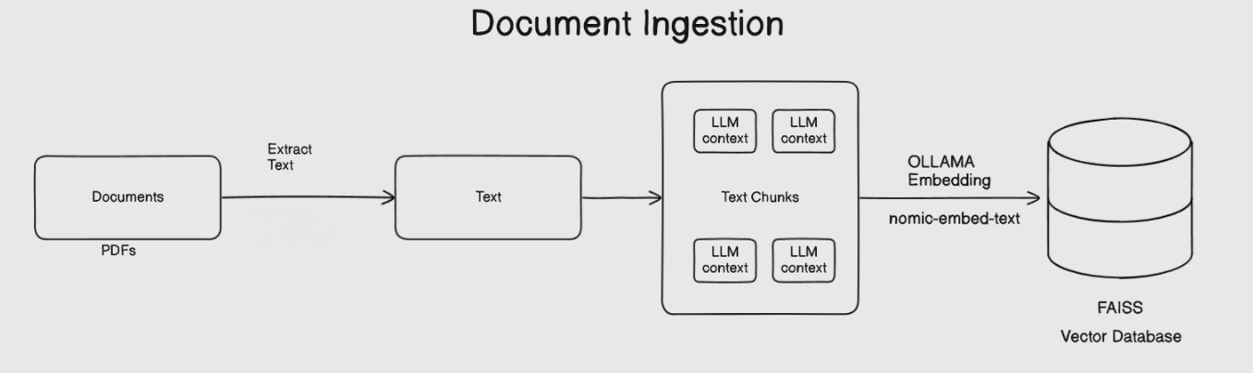
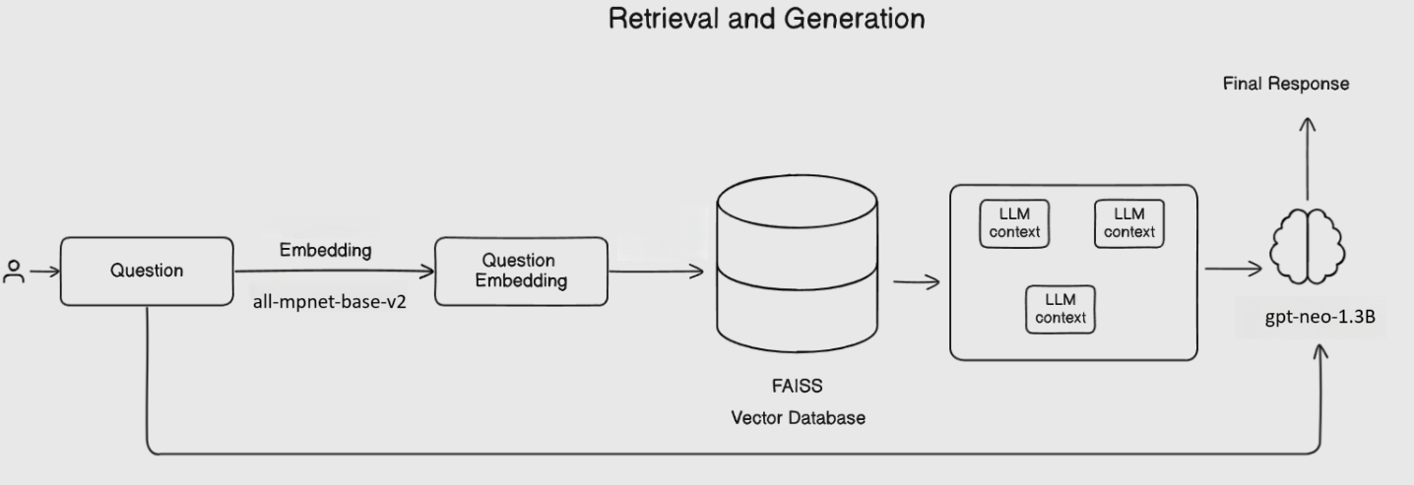
System Overview
Notes:
This slide provides an overview of the system, which automates the processing and querying of O-RAN documents.
Diagram 1: Document Ingestion Pipeline:
"This pipeline focuses on preparing the data for retrieval-based question answering:
First, documents in PDF and Word formats are loaded and processed.
The extracted text undergoes cleaning to remove unwanted patterns like excessive whitespace or repetitive characters. This ensures that the downstream embeddings are meaningful and consistent.
The text is then split into overlapping chunks to preserve context across boundaries. This overlap ensures that the retrieved chunks retain important information even if split between chunks.
Using the nomic-embed-text model, these chunks are embedded into vector representations that capture semantic meaning.
Finally, the embeddings are stored in a FAISS vector database, which enables fast and efficient similarity-based retrieval later on."
Diagram 2: Retrieval and QA Pipeline:
"This pipeline handles user interaction:
A user query is converted into a vector embedding using the sentence-transformers/all-mpnet-base-v2 model, chosen for its high-quality embeddings for textual similarity tasks.
The query embedding is compared against the FAISS database to retrieve the most relevant document chunks based on semantic similarity.
These retrieved chunks are passed as context to the gpt-neo-1.3B model, which synthesizes the information and generates a coherent, context-aware answer to the user’s query."

Slide 4
Literature Survey
Key Papers Referenced:
Sherlock on Specs: Building LTE Conformance Tests through Automated Reasoning:
"Inspired document-level analysis and automation."
Large Language Models for Networking: Opportunities and Challenges:
"Highlighted the need for domain-specific LLM fine-tuning."
Extracting Procedural Knowledge from Technical Documentation:
"Motivated embedding-based retrieval for procedural documents."
Notes:
I reviewed 10–15 papers, but the above three provided major insights that directly influenced the design and implementation of this project.

Slide 5
Implementation Details
Divided code into 5 parts for structured development:
Step 1: Document Loading and Preprocessing.
Step 2: Chunking Text.
Step 3: Embedding Generation.
Step 4: FAISS Index Creation.
Step 5: Retrieval-Based QA.
Tools and Libraries:
PyMuPDF, docx, JSON for document preprocessing.
FAISS for vector storage and similarity search.
SentenceTransformers and nomic-embed-text for embeddings.
Transformers library with gpt-neo-1.3B for QA.
Notes:
To ensure ease of development and debugging, I divided the project into 5 parts:
Step 1 handles document loading and preprocessing.
Step 2 splits the cleaned text into chunks with overlapping sections.
Step 3 generates embeddings for the text chunks.
Step 4 creates and stores FAISS indexes for efficient retrieval.
Step 5 retrieves relevant chunks and uses an LLM to answer user questions. This modular design makes it easier to manage each step independently and improve specific components as needed.

Slide 6
Challenges
Challenge 1: Handling Large Documents
Issue: O-RAN documents are lengthy, making them hard to process and embed in one pass.
Solution: Implemented dynamic chunking with overlaps to ensure context is preserved across splits while managing size constraints.
Challenge 2: Embedding Failures
Issue: API calls for embedding generation occasionally failed due to large inputs or connectivity issues.
Solution: Added retry mechanisms with truncated content to handle failures gracefully and hosted locally.
Challenge 3: Query and Index Dimension Mismatch
Issue: Query embeddings and FAISS index vectors need to have the same dimensionality for similarity searches.
Solution: Verified dimension alignment between embeddings generated by all-mpnet-base-v2 (query) and nomic-embed-text (chunks).
Challenge 4: User Query Understanding
Issue: Ensuring that the user’s natural language query is semantically interpreted to retrieve relevant results.
Solution: Used the sentence-transformers/all-mpnet-base-v2 model for high-quality semantic embeddings.
Challenge 5: Model Change from Llama to GPT-Neo
Issue: Initially planned to use Llama for question answering, but it was resource-intensive.
Solution: Switched to gpt-neo-1.3B, an open-source model that provided context-aware answers.
Notes:
Challenge 1: Handling Large Documents
"O-RAN documents are often hundreds of pages long. Embedding entire documents in one go is not feasible due to input size limitations of models like nomic-embed-text. To solve this, I implemented a dynamic chunking mechanism. It splits documents into smaller sections while maintaining contextual overlap to preserve semantic continuity across chunks."
Challenge 2: Embedding Failures
"During embedding generation, occasional failures occurred due to large chunk sizes or API issues. To address this, I added retry logic with truncation. If a failure is detected, the system automatically retries with a smaller input size, ensuring no data is lost in the process."
Challenge 3: Query and Index Dimension Mismatch
"The FAISS index requires all vectors to have the same dimensionality for similarity search. However, embeddings for the query and document chunks come from different models (all-mpnet-base-v2 and nomic-embed-text). I ensured dimensional consistency by validating embedding shapes before storing or querying the FAISS index."
Challenge 4: User Query Understanding
"Natural language queries vary in structure and intent. The sentence-transformers/all-mpnet-base-v2 model was chosen for its ability to generate high-quality semantic embeddings, ensuring that user queries are accurately matched to relevant document chunks in the FAISS index."
Challenge 5: Model Change from Llama to GPT-Neo
"Initially, I planned to use meta-llama/Llama-2-7b-chat for question answering. While Llama offers excellent performance, it is resource intensive. Due to time and resource constraints, I opted for gpt-neo-1.3B.
Benefits of Overcoming These Challenges
Scalability:
"Dynamic chunking allows the system to handle documents of any size."
Robustness:
"Retry mechanisms ensure embedding failures do not disrupt the pipeline."
Accuracy:
"Dimensional alignment and high-quality embeddings improve retrieval precision."
Practicality:
"Switching to GPT-Neo saved time and resources while still delivering reliable QA performance."

Slide 7
Evaluation and Future Testing Plans
Current Status:
System development is complete up to document ingestion, retrieval, and LLM-based QA.
Retrieval and QA workflows are functional but require rigorous testing and fine-tuning.
Planned Testing Metrics:
Query Processing Time:
Measure average time for query embedding, retrieval, and response generation.
Retrieval Accuracy:
Evaluate top-k retrieval precision for test queries.
Model Output Quality:
Conduct manual evaluation for answer coherence and relevance.
Notes:
Read

Slide 8
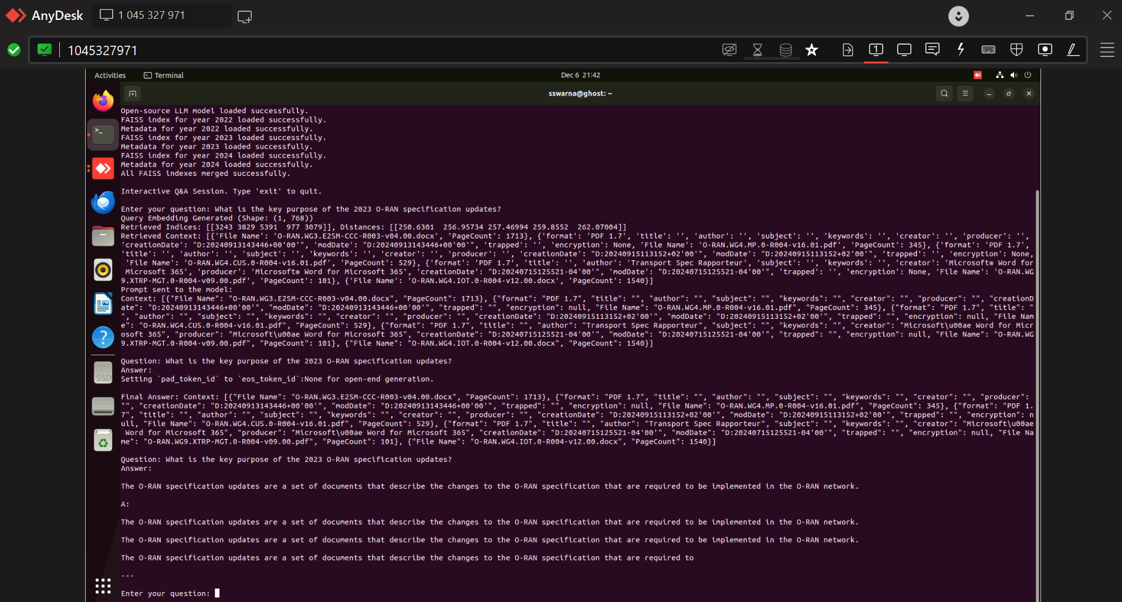
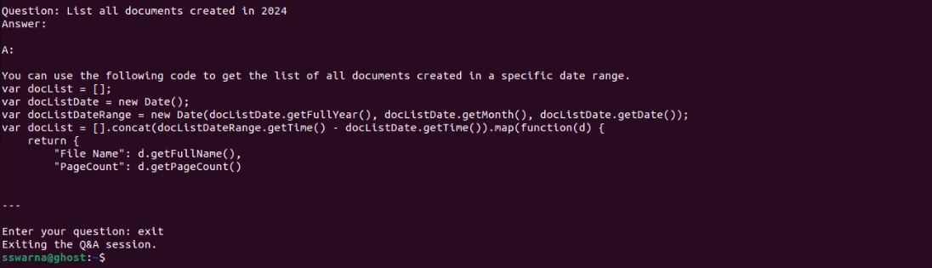
Continued
Notes:
In the first example, the query asks: 'What is the key purpose of the 2023 O-RAN specification updates?'
The system retrieves context from relevant document chunks in the FAISS database and passes it to the LLM (gpt-neo-1.3B), which generates an accurate response about the specification updates."
The second example demonstrates the system's ability to answer a query about document details: 'List all documents created in 2024.'
The system processes the query, retrieves relevant metadata from the database, and provides a list of document details, such as file names and page counts.

Slide 9
Summary
Project Overview:
Built an end-to-end system for document ingestion, retrieval, and question answering.
Modular structure with five distinct steps:
Document Loading → Chunking → Embedding → Retrieval → Question Answering.
Key Achievements:
Successfully processed and stored embeddings for 115 O-RAN documents.
Implemented retrieval-based question answering with contextual responses.
Integrated FAISS for efficient vector similarity searches.
Lessons Learned:
Importance of modularity for streamlined development and debugging.
Effective text cleaning and dynamic chunking improved embedding quality and retrieval accuracy.
The choice of embedding models (nomic-embed-text and all-mpnet-base-v2) significantly impacted system performance.
Splitting documents by page and chunking resolved scalability challenges for large documents.
Future Work:
Comprehensive system testing to validate query accuracy and scalability.
Adding summarization for concise overviews of O-RAN documents.
Fine-tuning or exploring new LLMs for domain-specific QA (e.g., Llama-2).
Validating outputs with domain expert feedback.
Notes:
Read

Slide 10


